Slide 1
Choose Your Own Adventure Game
Jennifer Meara
Hackbright Bootcamp Prep
April 12, 2018
Notes:
For my personal project, I created a choose your own adventure game.

Slide 2

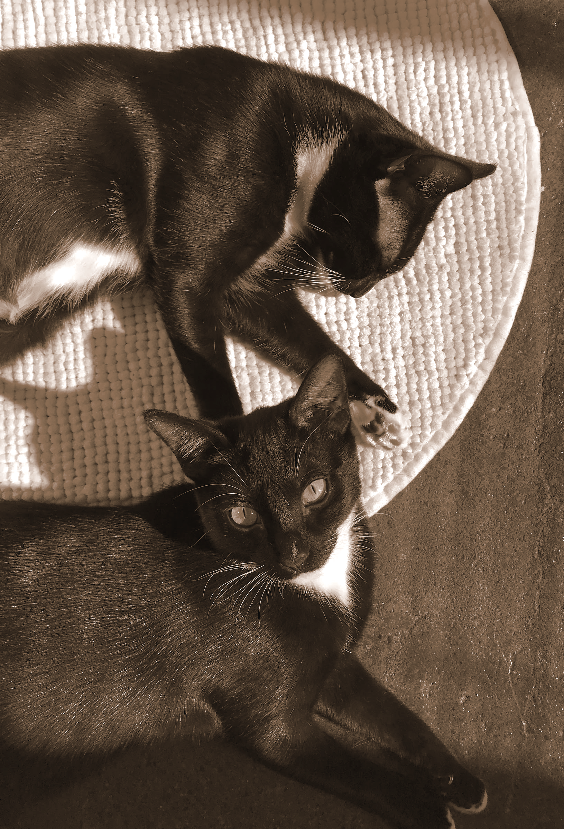
Choose Your Own Adventure Game
Favorite TV Show
Favorite Animals
+
=
Notes:
When trying to decide on a theme, I wanted to be inspired by some of my favorites:
Starting with one of my favorite TV shows: WestWorld, about a futuristic western theme park populated by A.I. hosts.
And one of my other favorites… Cats! And yes, these are my two kittens, Kona and Iki.
Combining those...

Slide 3
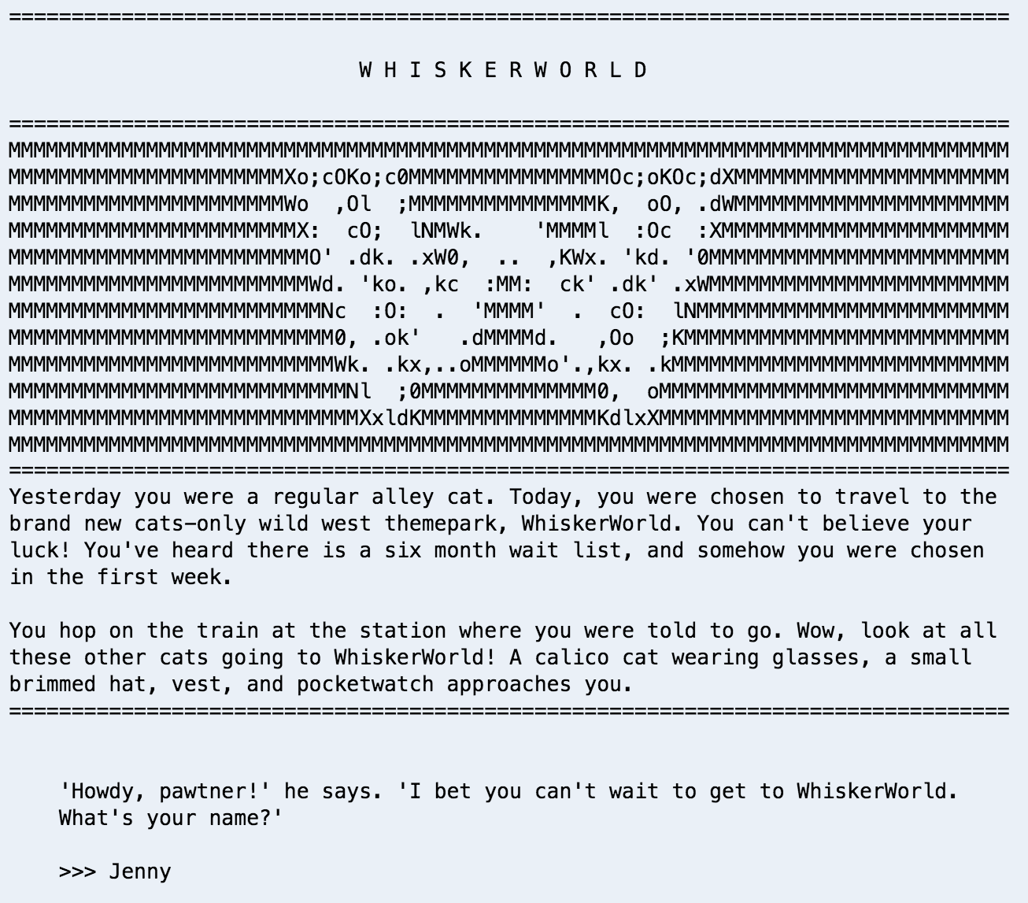
Welcome to… WhiskerWorld!
PG, feline-friendly, wild west game
Meet many of the favorite WestWorld characters in cat form: Teddy Fleas, Dolores Abermeowthy, Hisstor Eskitten.
User makes choices to advance the storyline and earn XP.
If user wins, they’re assigned a special, cowboy nickname.
Besides conditional statements tracking user progress/choices, how could I make the story more interactive for the user?
Notes:
I’ve created WhiskerWorld! It’s a G-rated, feline-friendly, Wild West game with plenty of cat puns and cowboy slang. User choices advance the storyline and earn experience.
As I was building the story, besides tracking the user choice of option A or option B, I wondered how I could make the story more interactive.

Slide 4
WhiskerWorld Minigames
Race segment has a difficulty randomly assigned
User enters a power number between 1-5
If too much power for the segment, they go to fast and tumble off track.
Game tracks total points. First to 50 points wins.
Racing game:
User chooses area they want to attack (head, back, belly, tail, etc…) Game randomly chooses one area for Hisstor to block. User gets points for a hit.
User chooses area to block. Game randomly chooses one area for Hisstor to attack, and gets points for hit.
First to lose all health points, loses.
Cat fight game:
User rolls 6 dice and gets score. User can reroll dice of their choosing up to 3 times. Final round score.
Game simulates Lion (Lyin’) Leo rolling dice and getting round score.
Continues until user or Lion Leo reach 2000 points.
Dice game:
Notes:
So I decided to create some minigames to break up the story. So far, I’ve coded 3 minigames. A racing game, a fighting game and a dice game. The dice game was the most challenging so far because I had to track 6 dice for the user, allow the user to select and reroll dice up to three times per turn, calculate points when different dice have different point values, simulate the other character’s points, and stopping the game when a player hits 2000 points.

Slide 5
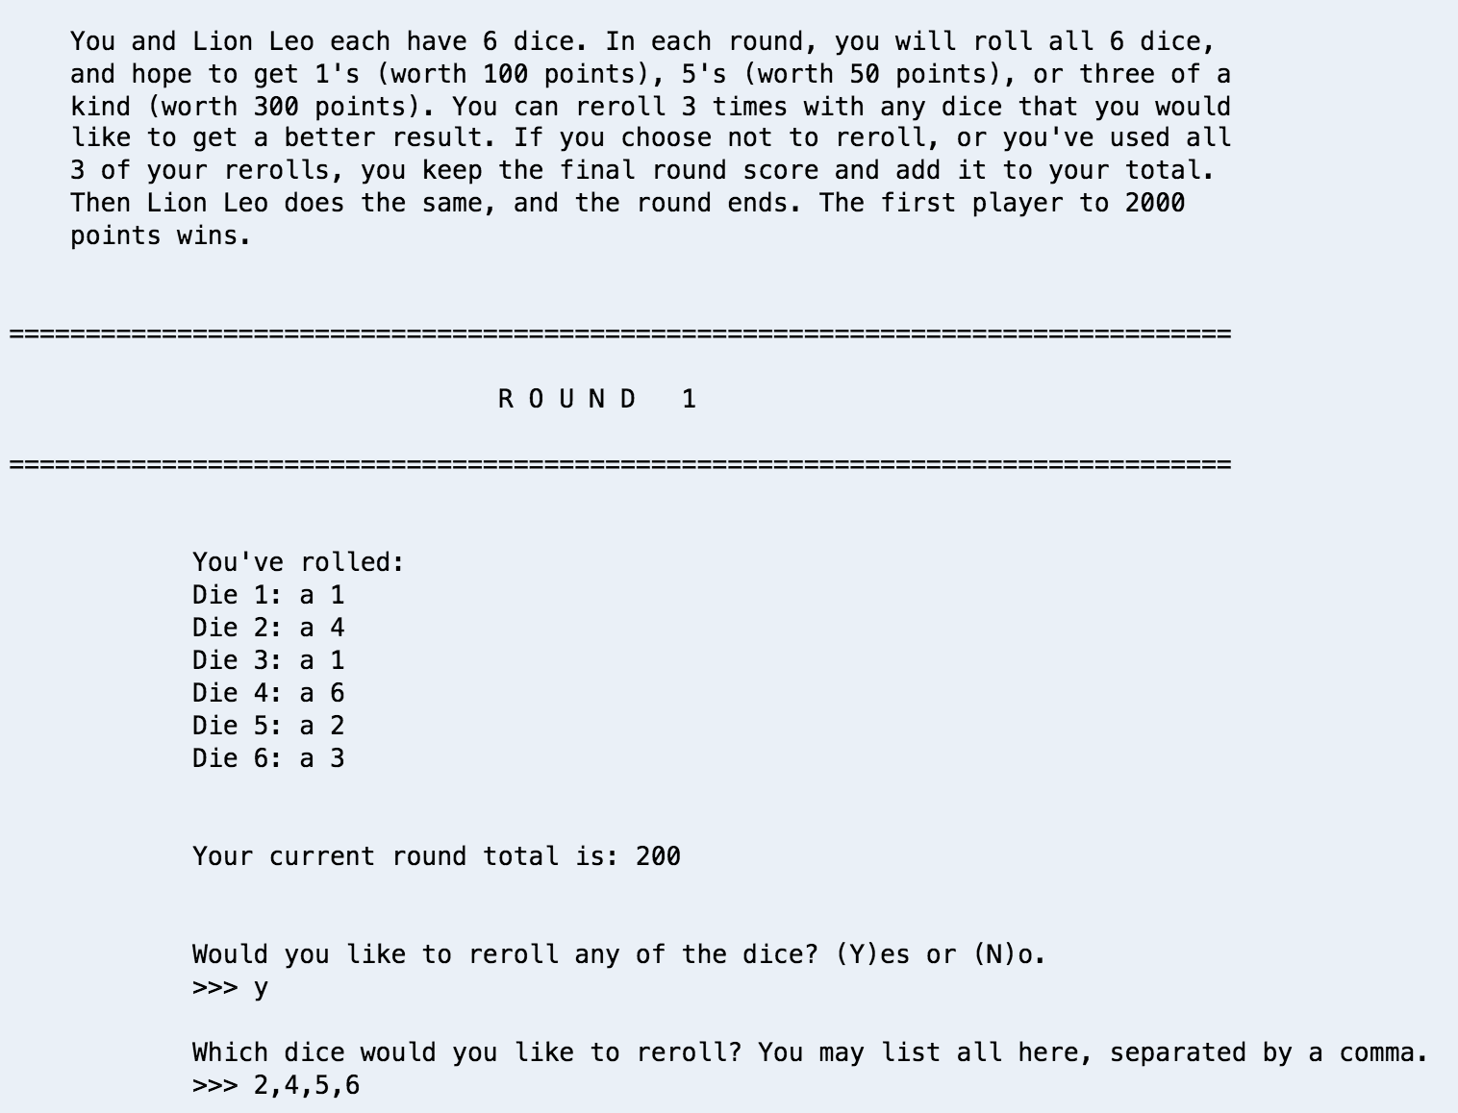
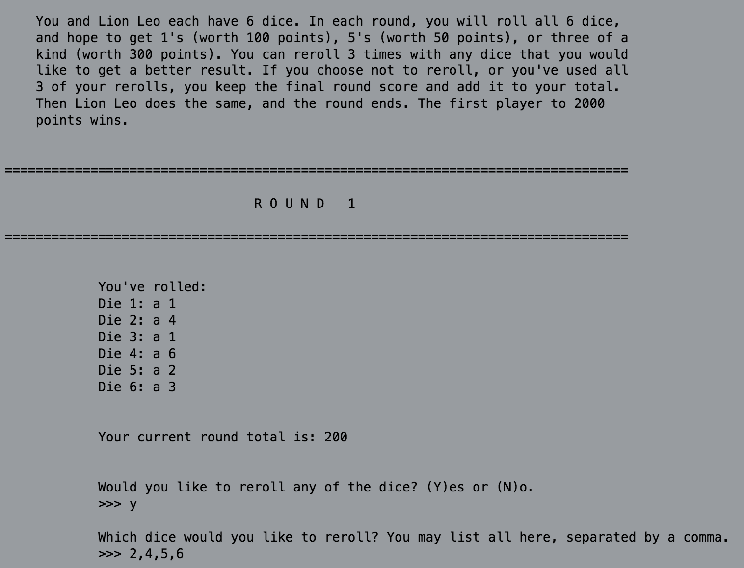
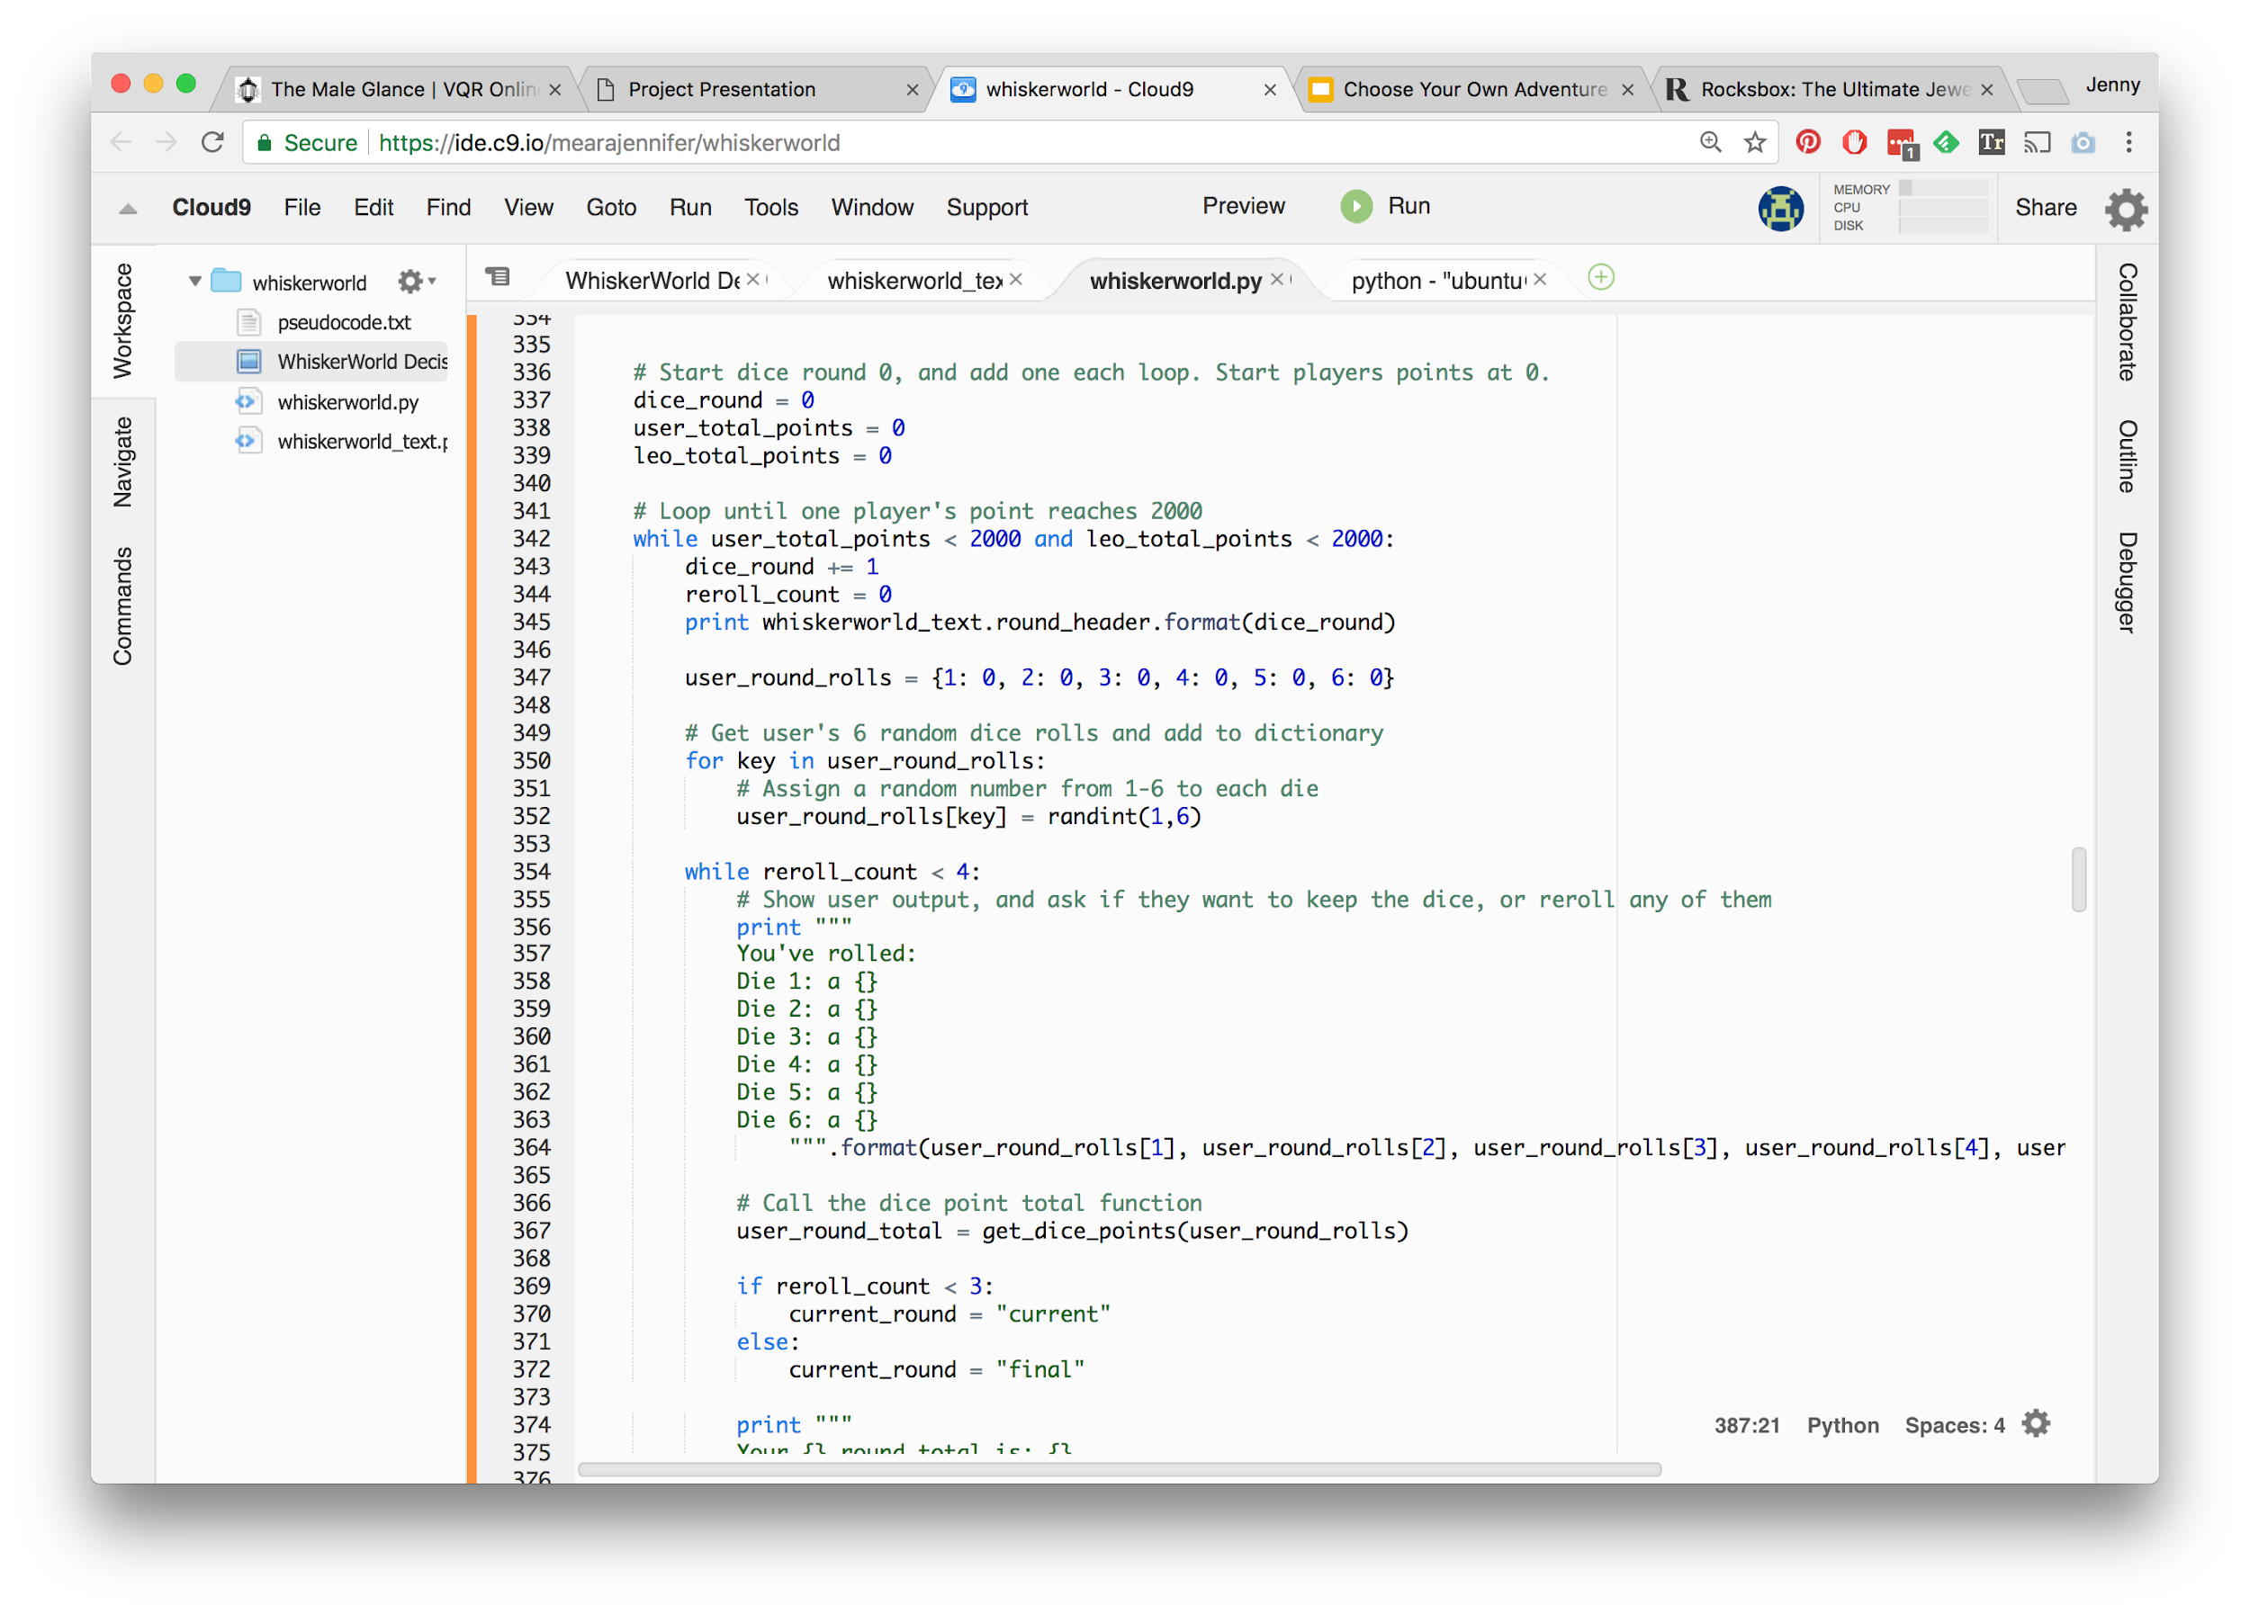
WhiskerWorld Dice Minigame
Notes:
When the user starts the game, it first prints the directions, the round number, and the user’s first roll.
Looking at the code, we start tracking dice round, which starts at 0. And player points, which both start at 0.
Then we enter a loop that continues until one of the players reaches 2000 points. We add 1 to the dice round. We start a new counter for rerolls. And we set up a dictionary to store what the user has rolled for each die, currently set to zero. Then we go through each key in the dictionary and randomly assign a value between 1 and 6 to each die.
Then we enter a second while loop, that continues as long as the user has rerolled 3 or fewer times, and we show the user their first round roll.

Slide 6
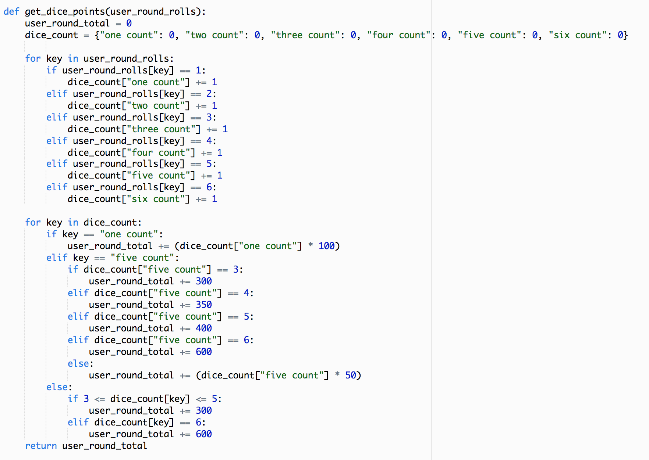
WhiskerWorld Dice Minigame
Notes:
The next piece of data is the user’s total.
I actually created another function, get dice points, which imports the user round rolls dictionary info.
Basically this function counts up how many of each number they’ve rolled, and totals up the points. It’s tricky because of the various points assigned to 1’s (100 points each), 5’s (50 points each) and three of a kind (300 points).

Slide 7
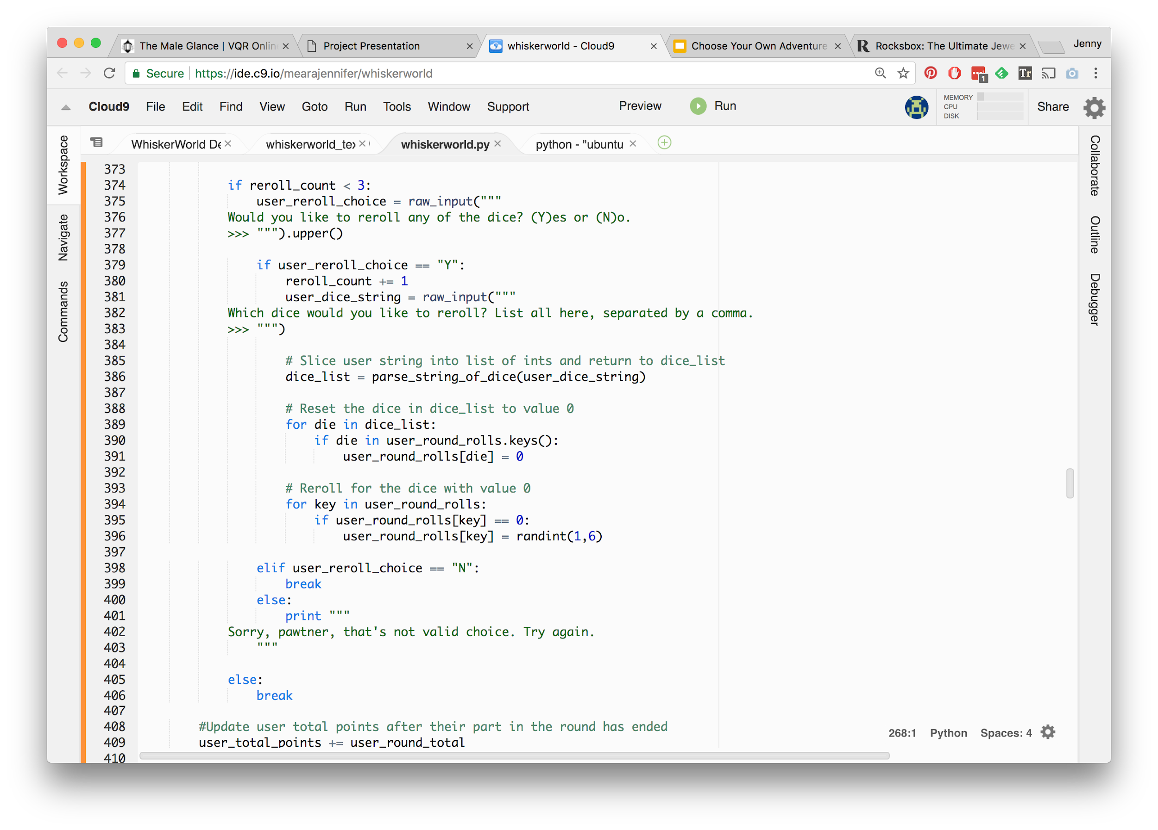
WhiskerWorld Dice Minigame
Notes:
The next part of the game deals with rerolling any dice that the user wants.
First we evaluate if the user has hit their reroll limit of three. If they haven’t yet, then we ask them if they want to reroll.
If they choose yes, we add one to the reroll count. Then we ask them which dice they want to reroll. We use another function that I won’t go into here, but it basically separates the string into a list of integers.
Then we reset the selected dice and reroll them to a new number between 1 and 6 again.
When the user’s rolls are over, either by selecting to not reroll or hitting their limit of 3 rerolls, it updates the user’s total points.

Slide 8
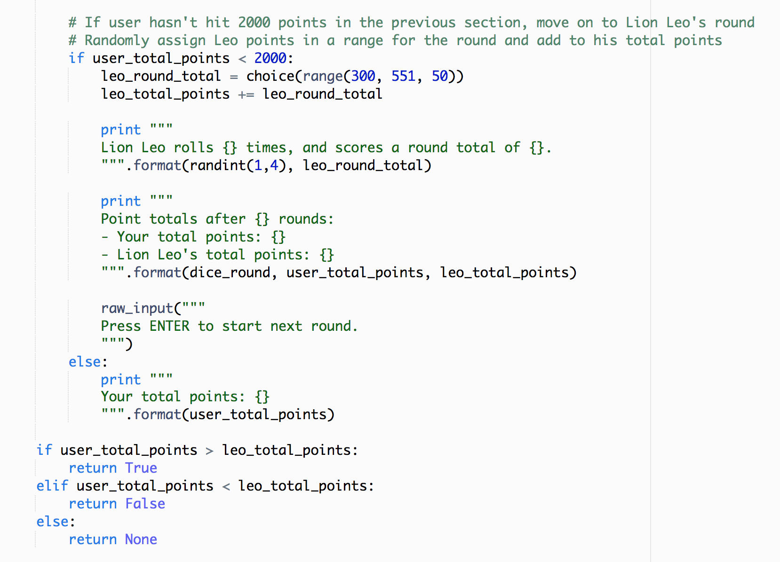
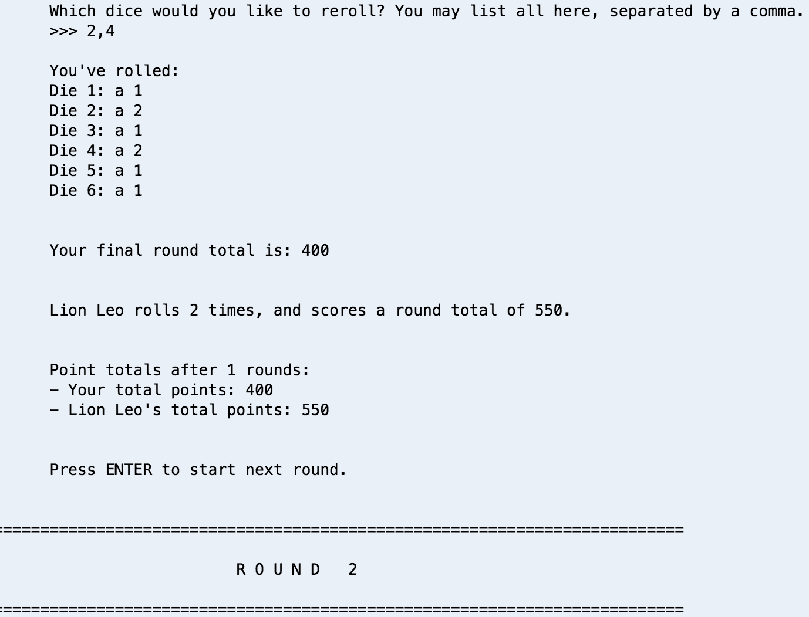
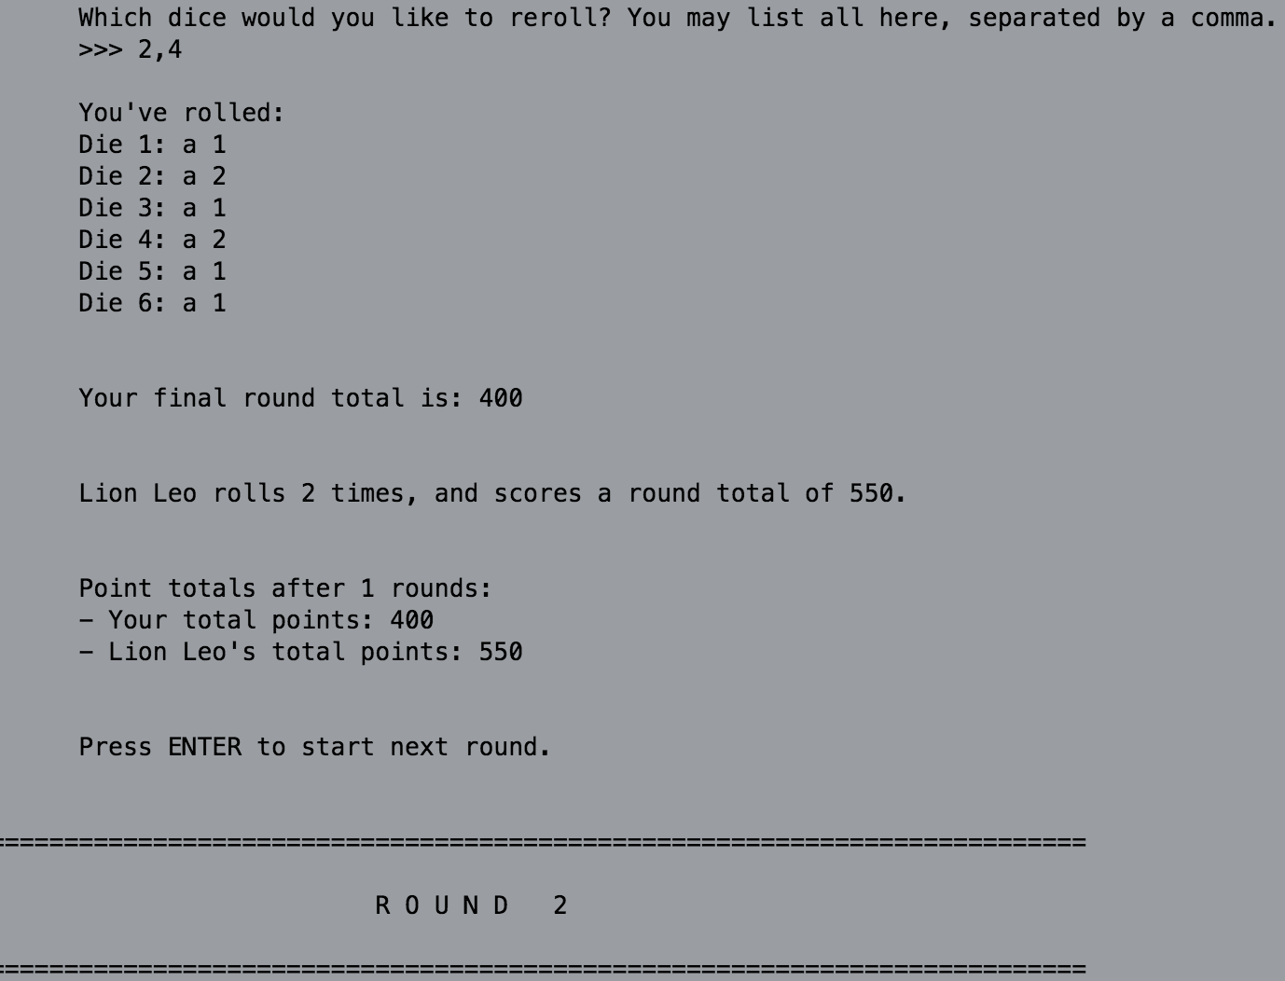
WhiskerWorld Dice Minigame
Notes:
Then we have to simulate Lion Leo’s points.
First we want to see if the user has won the game, and if not, I simplified this a bit, so Leo randomly gets a value between the most likely point totals in a 50 point interval from 300 to 550. Then we report Leo’s points.
Now that both players have played the round we print out the standing totals, and loop around to start the next round.
Once one of the players hits 2000 points, we evaluate whether the user or Leo has more points, and return that data back to the main dictionary that tracks the user’s info in the game.

Slide 9
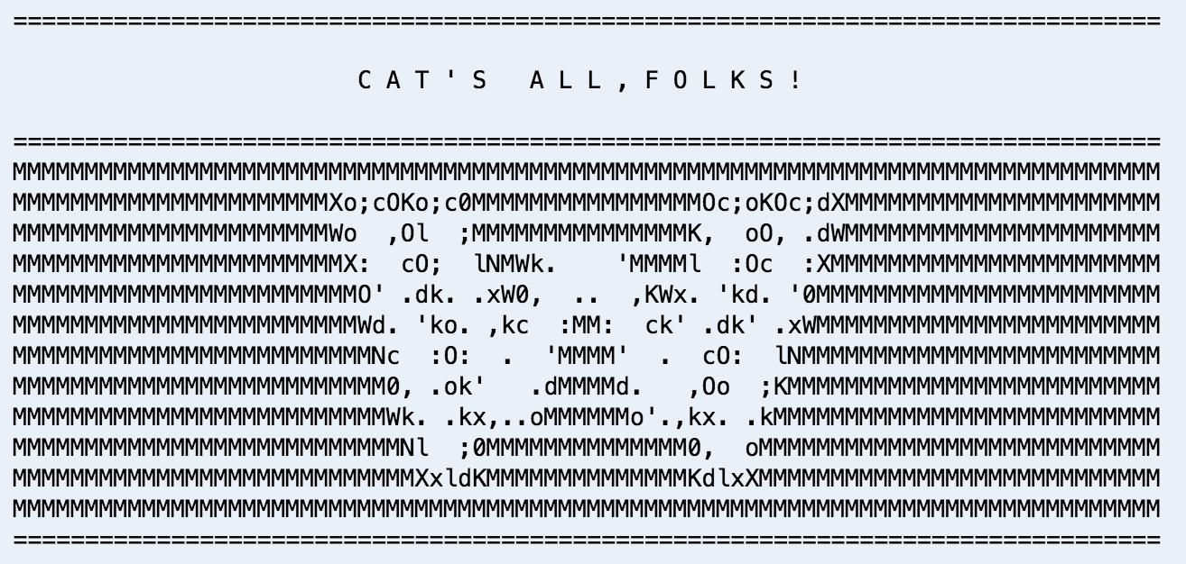
WhiskerWorld

